Slide 1

Guide to Assessment 2, Part 2 评估指南 2，第 2 部分

Slide 2
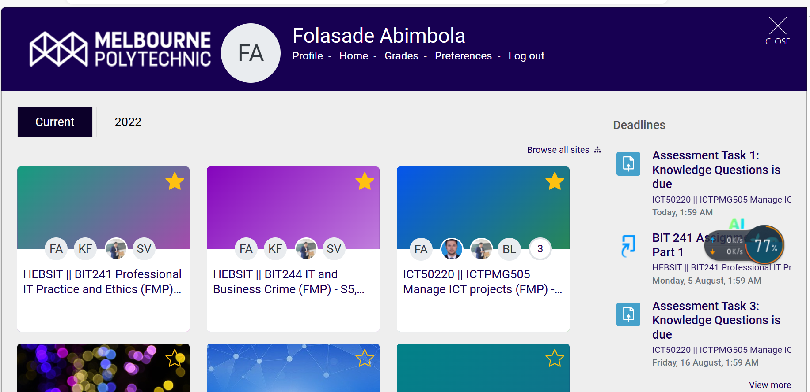
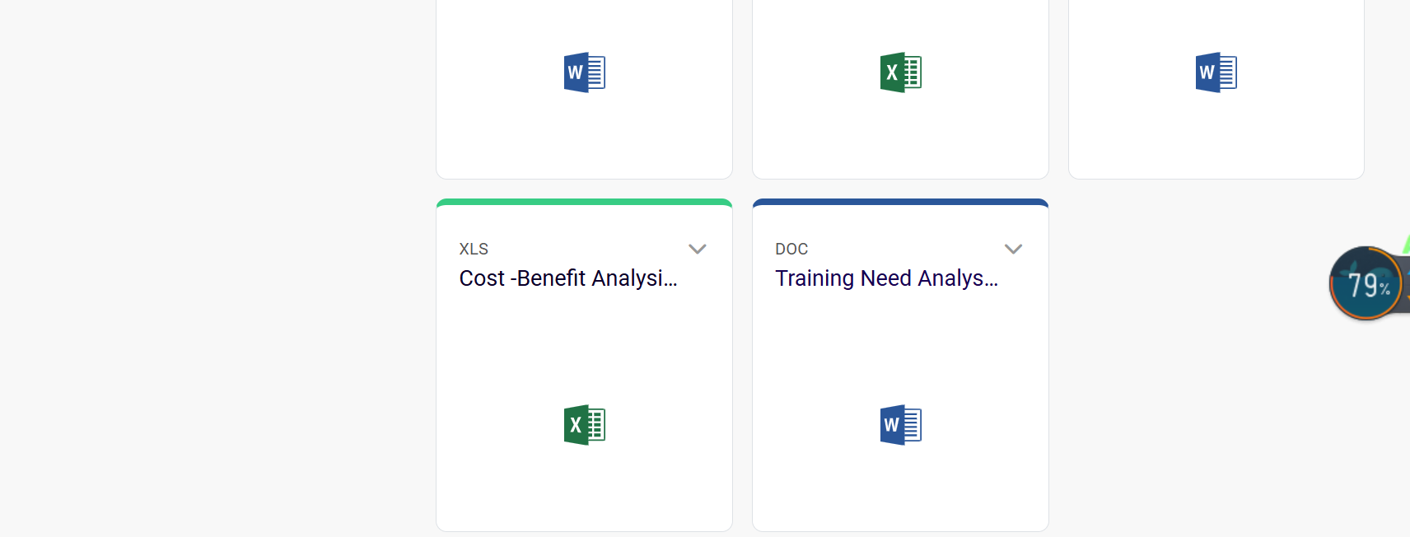
Assessment 2, Part 1 for Week 1 explained 第 1 周的评估 2，第 1 部分解释
Please log in to your Student Portal @ Moodle. 请登录您的学生门户@Moodle。
Find Manage ICT Projects 查找 管理 ICT 项目
Click on assessment, Click assessment 2 and download this file单击评估，单击评估 2 并下载此文件

Slide 3
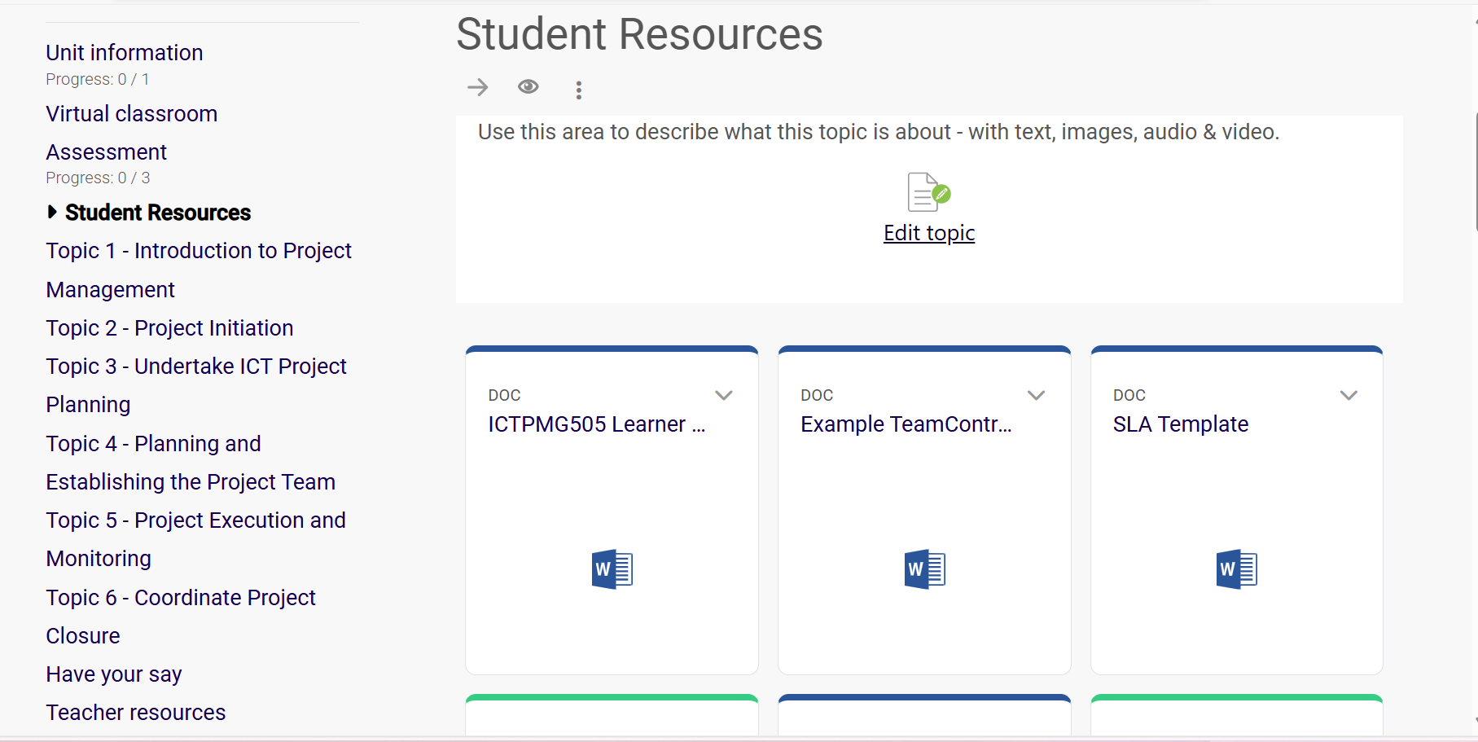
All documents can be downloaded from students resources 所有文件都可以从学生资源中下载

Slide 4
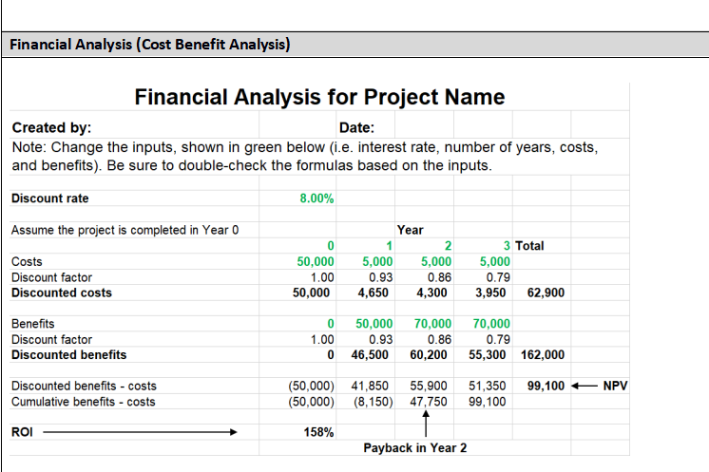
A quick flip back to Part 1, task 4, Cost benefit Analysis 快速切换回第 1 部分，任务 4，成本效益分析 Please download “Cost benefit analysis doc from students site, and complete it to add to Part 1 supporting documents 请从学生网站下载“成本效益分析文档”，并完成以添加到第 1 部分支持文档

Slide 5
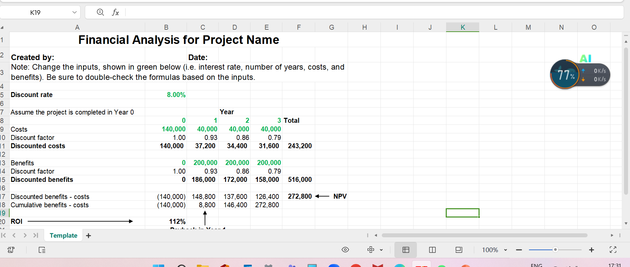
Insert your name and date here, and save file as “Cost benefit analysis, student Id, student name”. 在此处输入您的姓名和日期，并将文件保存为“成本效益分析、学生 ID、学生姓名”。 This will be our additional doc No 1 for Assessment 2 这将是我们评估 2 的附加文档 1 号

Slide 6
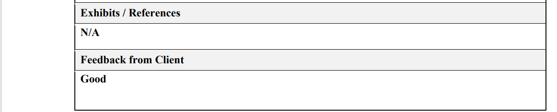
Then in Part 1 Task 4, please change all input here to follow as this 然后在第 1 部分任务 4 中，请更改此处的所有输入，如下所示

Slide 7
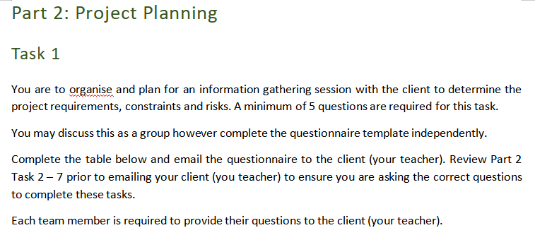
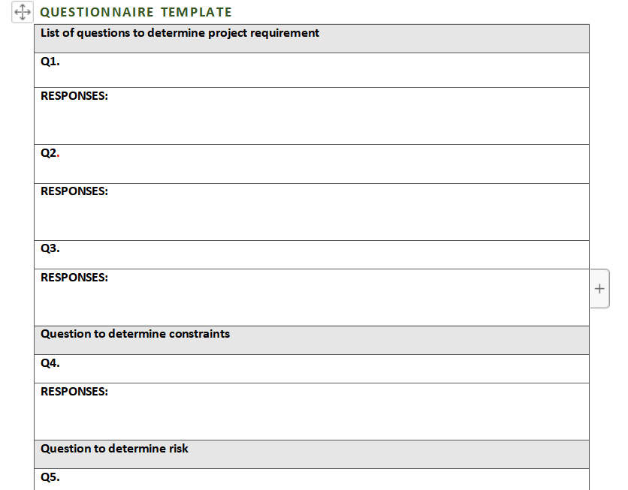
Now to Part 2, Task 1-task 6 现在转到第 2 部分，任务 1-任务 6

Slide 8
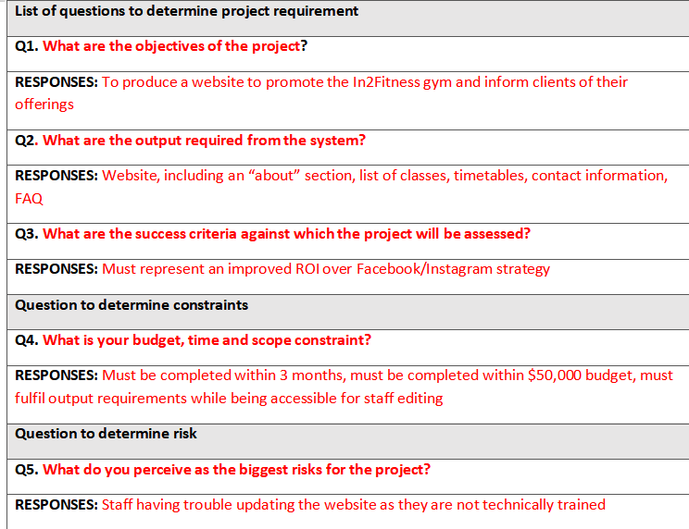
Example answers to Part 2, Task 1 第 2 部分任务 1 的示例答案
DO NOT COPY AND PASTE

Slide 9
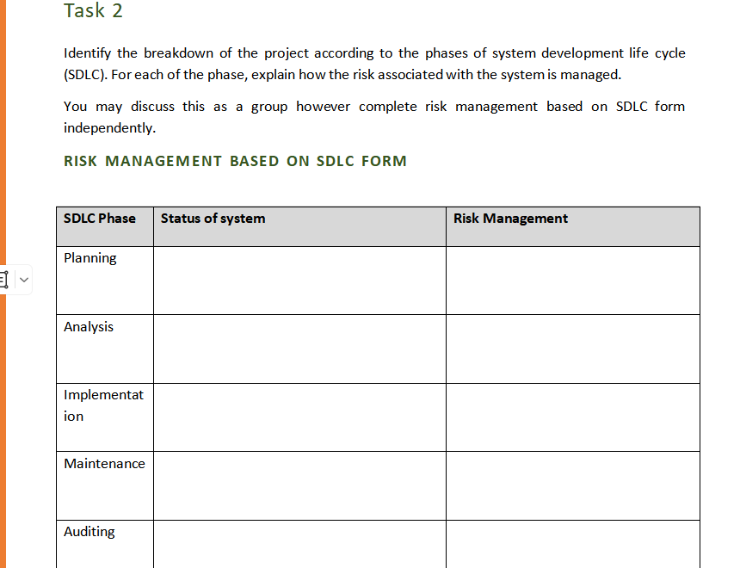

Slide 10
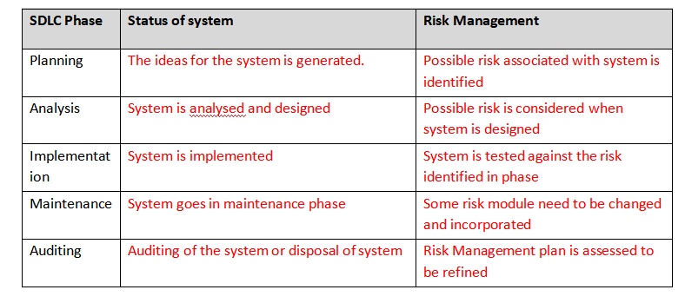

Example answers to Part 2, Task 2 第 2 部分任务 2 的示例答案

Slide 11
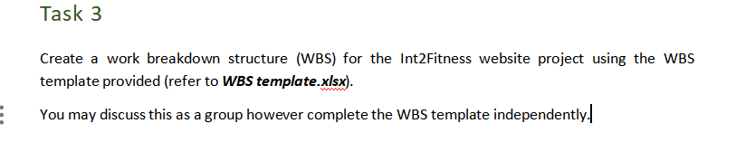
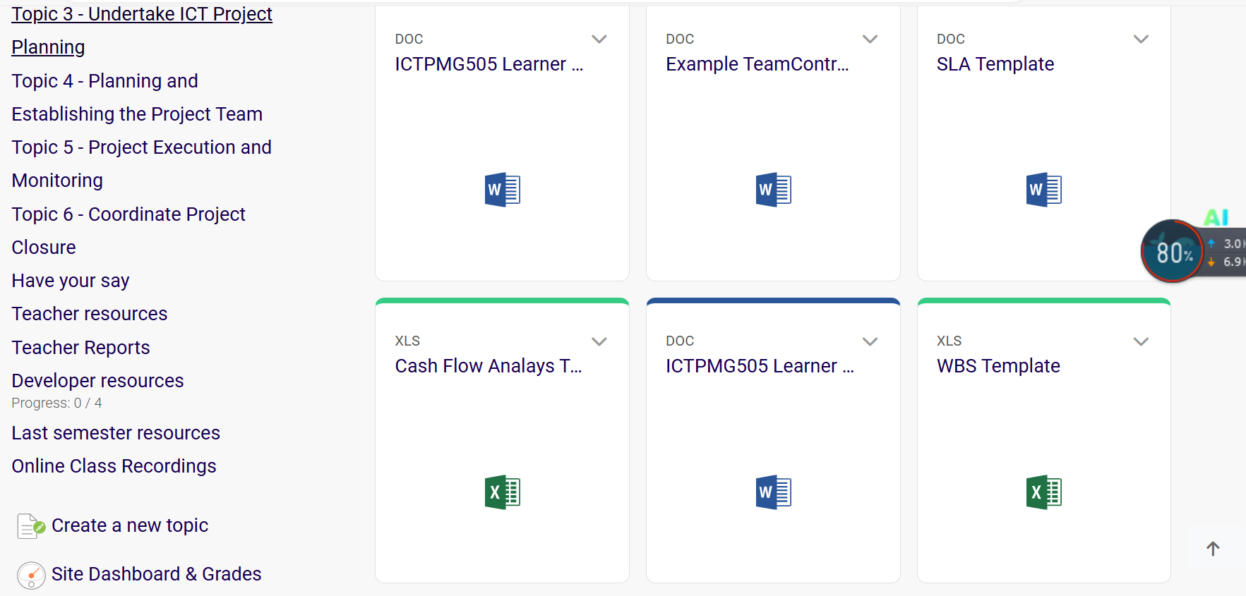
Please note that all documents must be completed individually, but you can discuss how to complete them as a group 请注意，所有文件必须单独填写，但您可以讨论如何以小组形式完成
Please download Document WBS template from your Moodle site (This will be additional document No 2). Please rename as WBS-Student name-student ID No
请从您的 Moodle 网站下载文档 WBS 模板（这将是附加文档第 2 号）。请重命名为WBS-学生姓名-学生证号

Slide 12
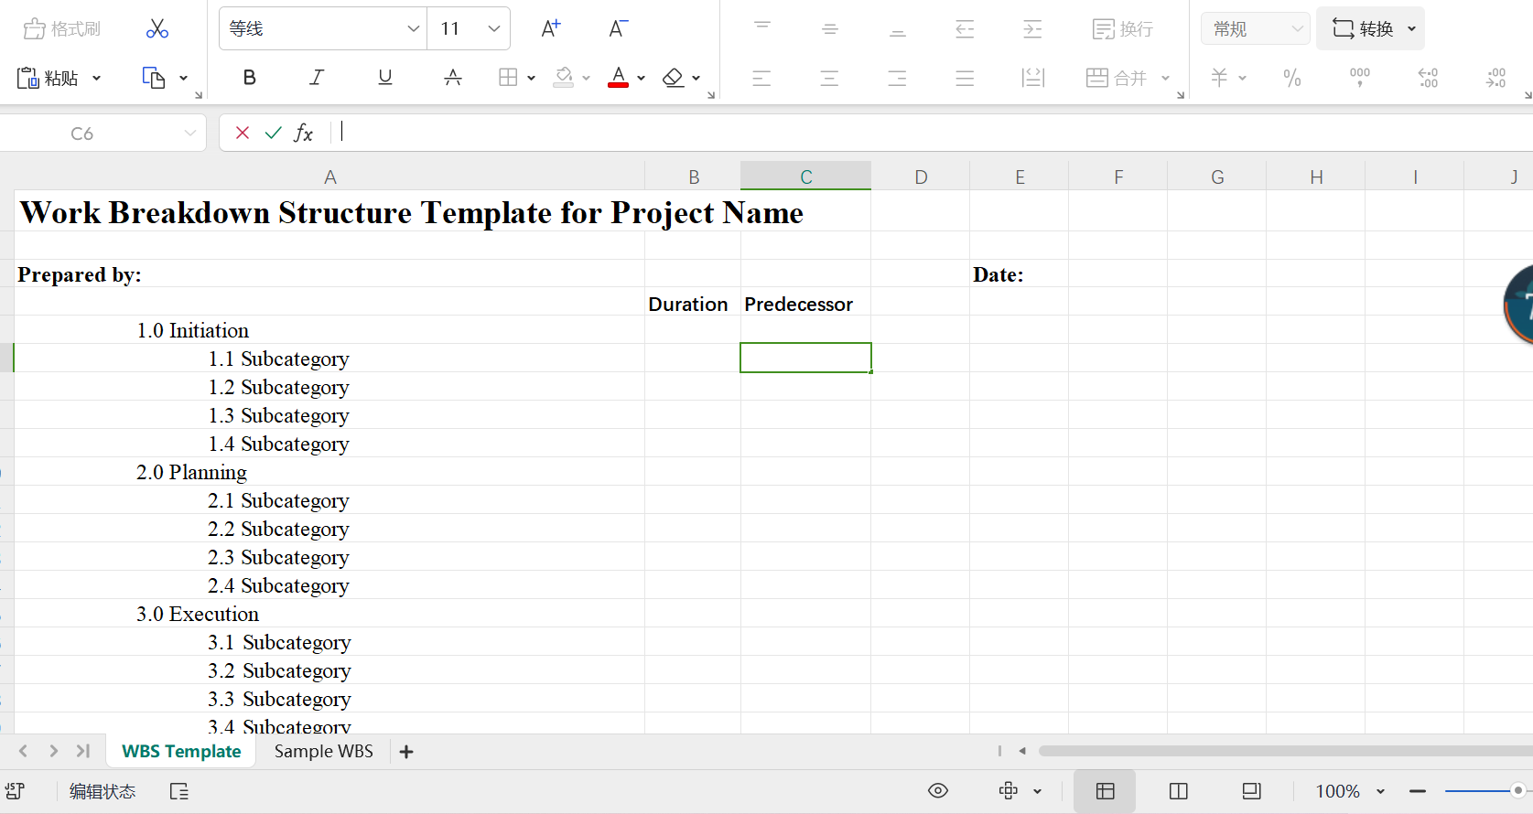
Insert your name 插入名称 Insert date插入日期 Change subcategories to fit in In2fitness scenario items更改子类别以适应 In2fitness 方案项 Fill in the duration for each plan/subcategories 填写每个计划/子类别的持续时间
Change subcategories inhere to IN2FITNESS ITEMS
Please see next slide for example

Slide 13
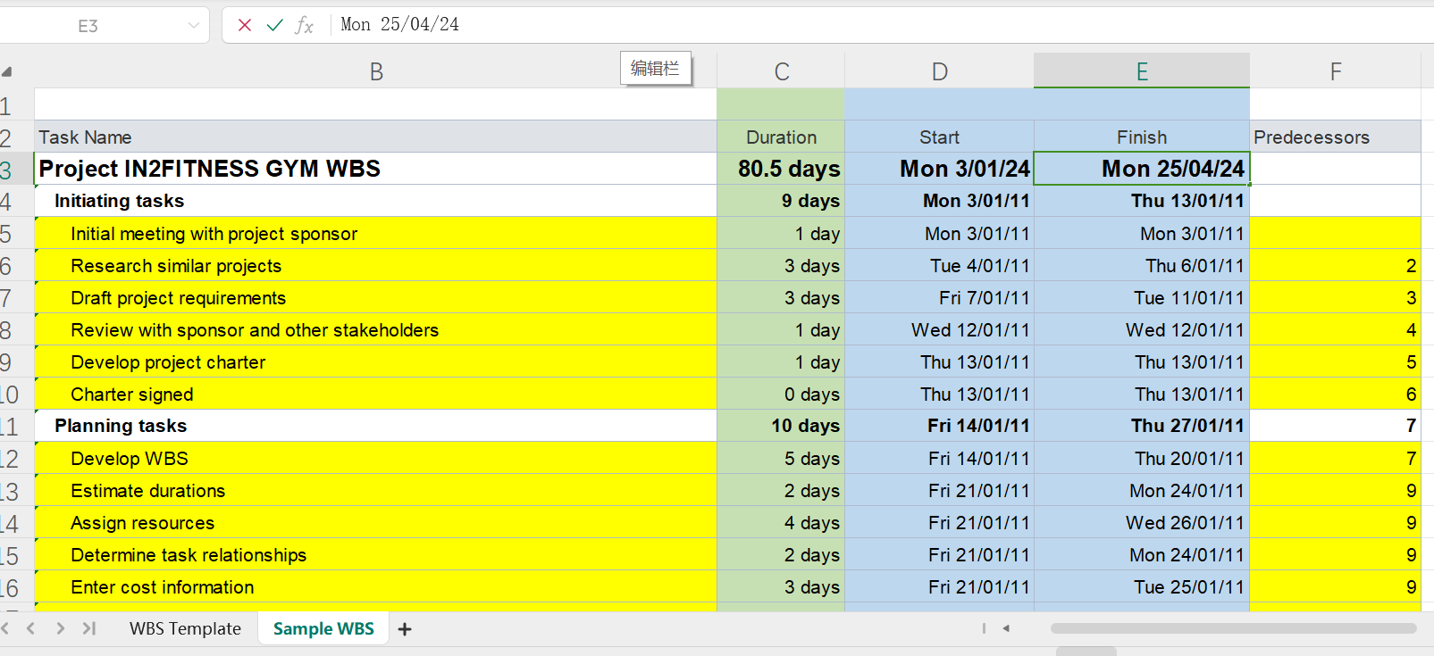
Please refer to sheet 2 WBS template for example 例如，请参阅表 2 WBS 模板
You can modify the table Sample WBS for your use 您可以修改表示例 WBS 以供使用
Edit the dates (2024), edit the data 编辑日期 （2024），编辑数据
The duration of each category, the start date and the finishing date must be included as shown 每个类别的持续时间、开始日期和结束日期必须包括在内，如图所示

Slide 14
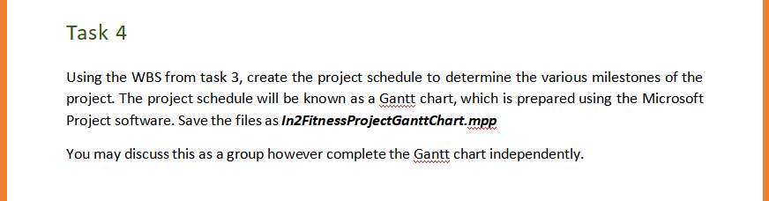
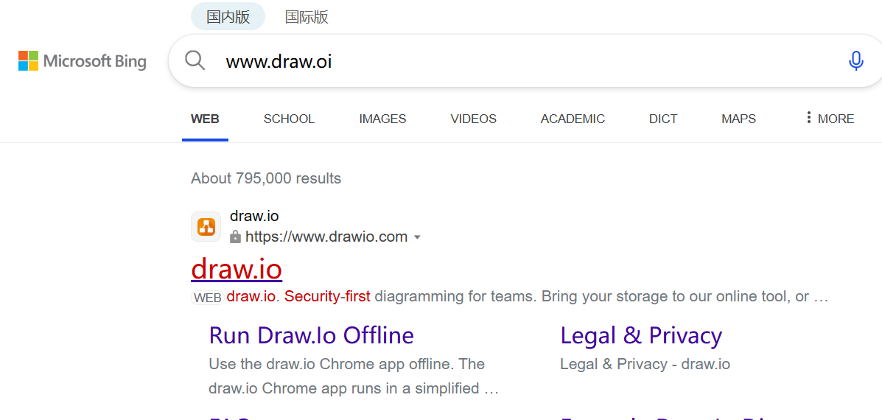
Task 4: We are to prepare a Gantt chart for In2fitness Gym project, we will use the project schedule we designed in our WBS documents 任务 4：我们将为 In2fitness Gym 项目准备甘特图，我们将使用我们在 WBS 文档中设计的项目时间表 Step 1: You can visit www.draw.oi using Microsoft edge, google or any other search engineor use any other chart software you are familiar with.步骤1：您可以使用Microsoft Edge，Google或任何其他搜索引擎访问www.draw.oi，或使用您熟悉的任何其他图表软件

Slide 15
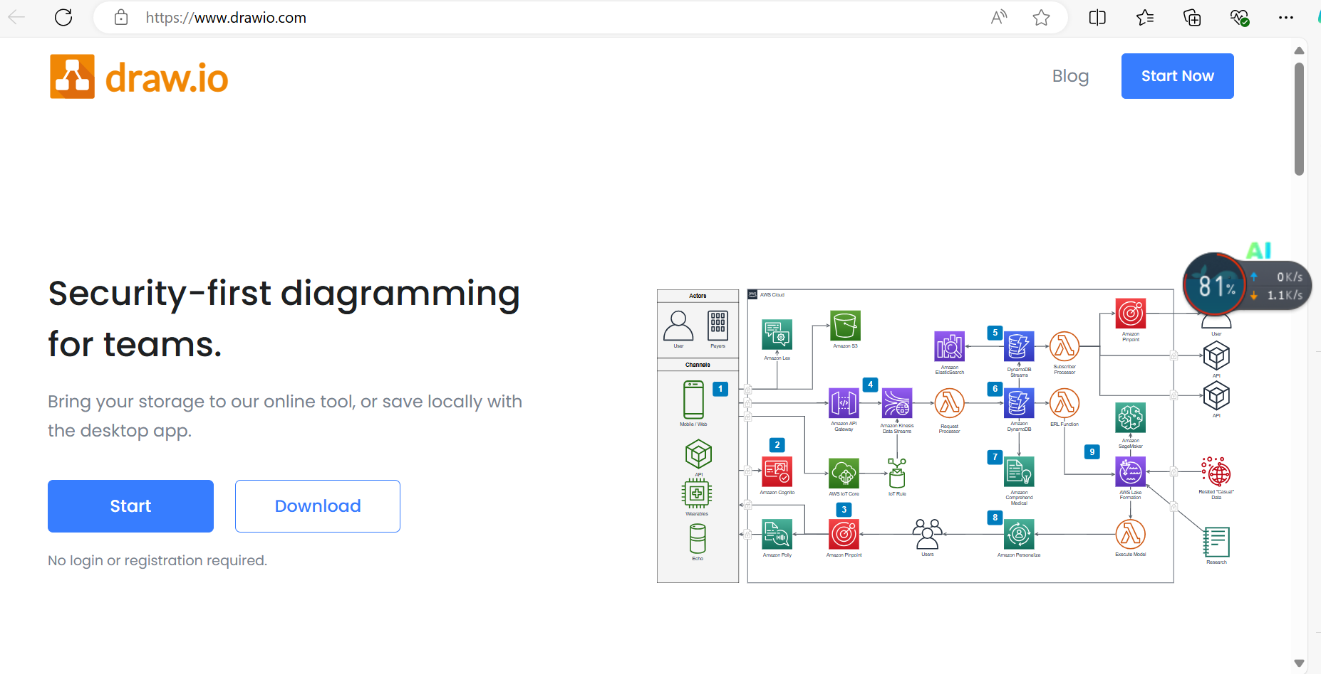
Click “start”

Slide 16
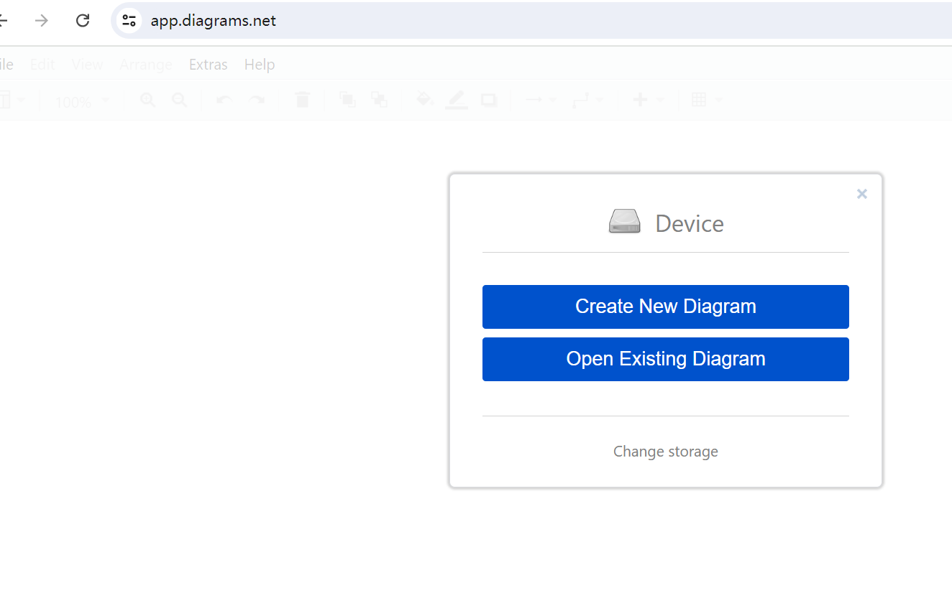
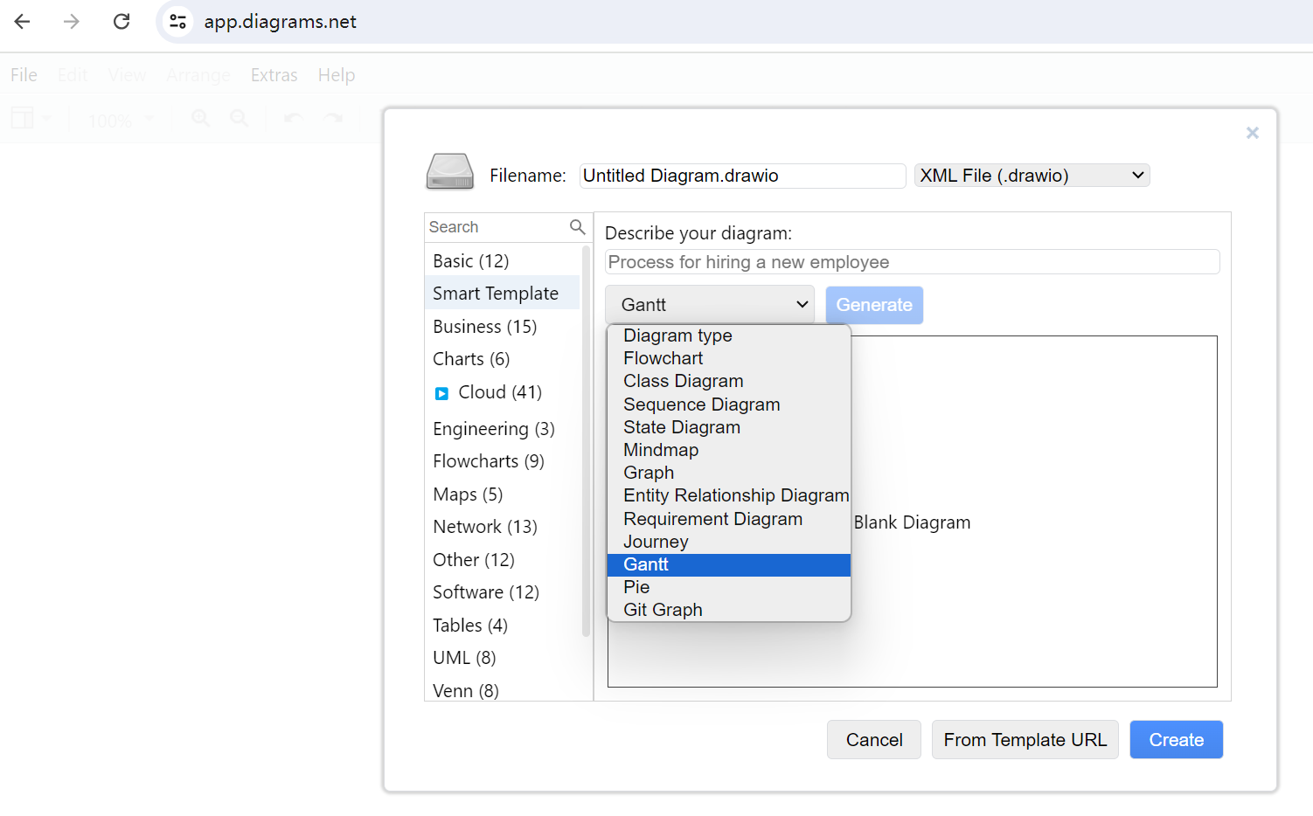

Slide 17
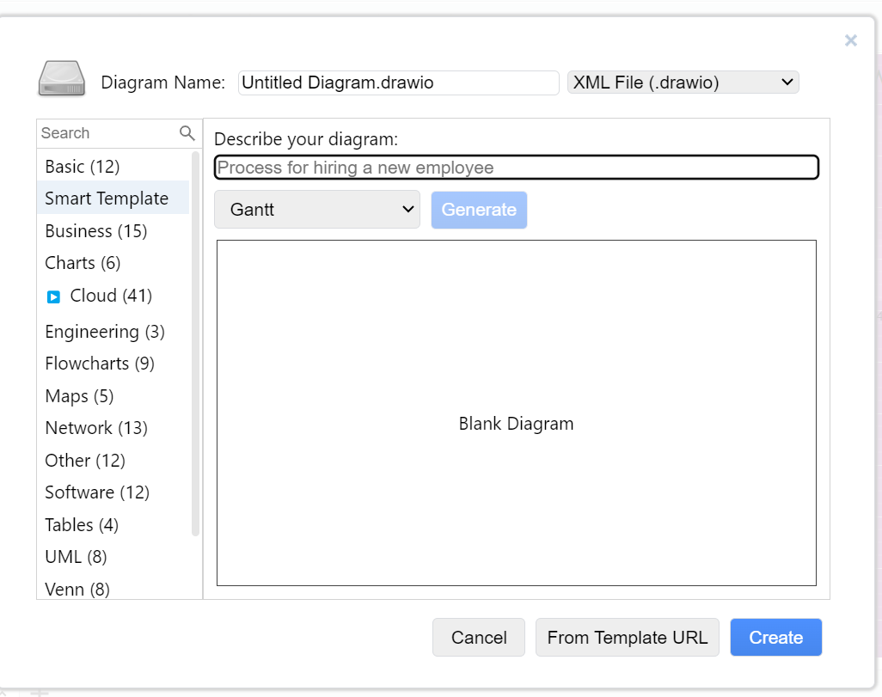
Copy and paste all your data from the WBS document and paste in this space 从 WBS 文档复制并粘贴所有数据并粘贴到此空间中 Click on “Generate”点击“生成” You can adjust the background, edit the data, change colour depending on you 您可以根据自己调整背景、编辑数据、更改颜色 Save file as In2fitGantt-Student ID-student name 将文件另存为 In2fitGantt-Student ID-student name

Slide 18
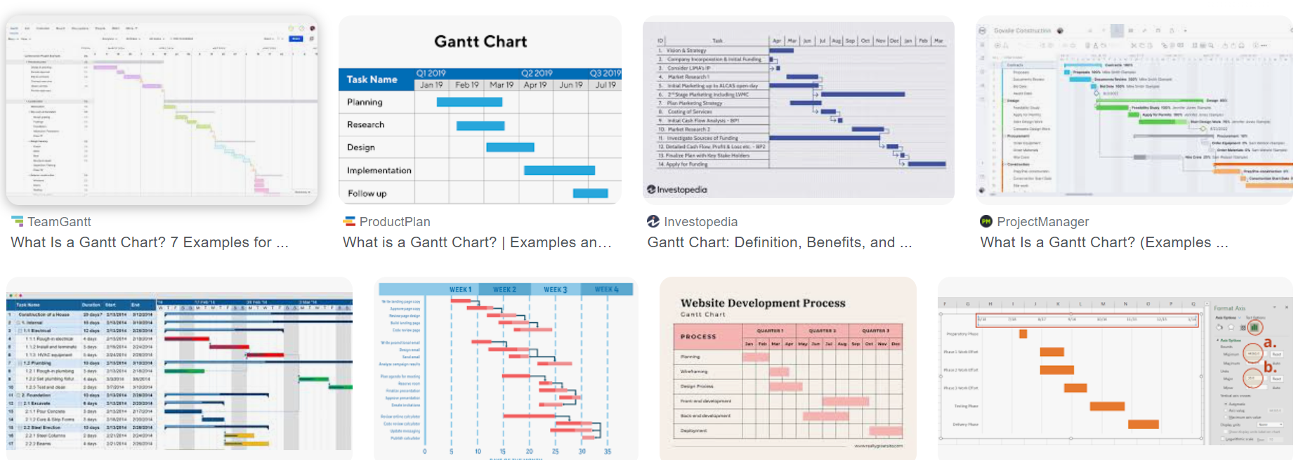
Gantt Chart results will differ depending on your data input甘特图结果会因数据输入而异

Slide 19
Please save Gantt chart file as In2fitGantt-Student ID-student name 将文件另存为 In2fitGantt-Student ID-student name This will be our additional doc No 3 for Assessment 2 这将是我们评估 2 的附加文档 3号

Slide 20
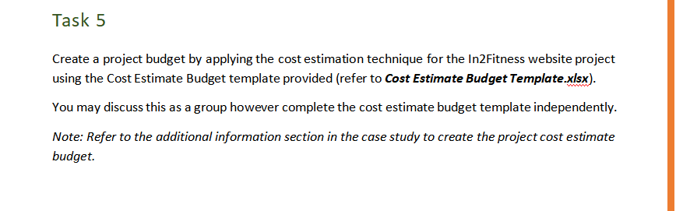
Please download doc “Cost estimate budget template from Moodle site” 请从“Moodle网站”下载“成本估算预算模板”文档 Please refer to additional information section in the case study to create the cost estimate budget 请参阅案例研究中的“其他信息”部分，以创建成本估算预算

Slide 21
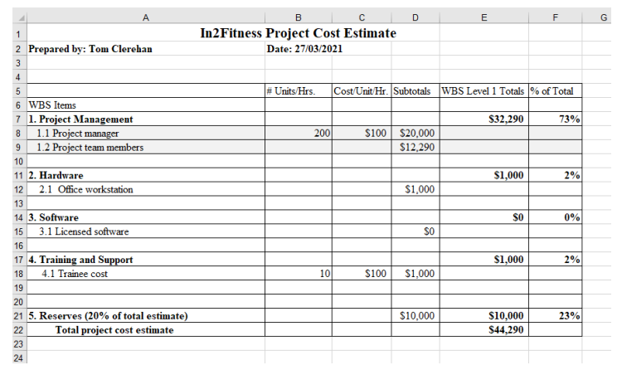
Example “Cost Estimate Budget” doc
DO NOT COPY AND PASTE

Slide 22
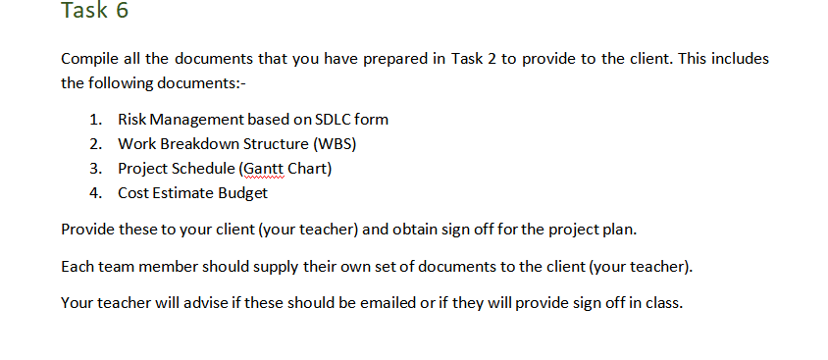
Check that you have completed the following documents appropriately Save each doc with Doc name- student ID and Student number Get all the documents ready to be checked by your client @Folasade

Slide 23
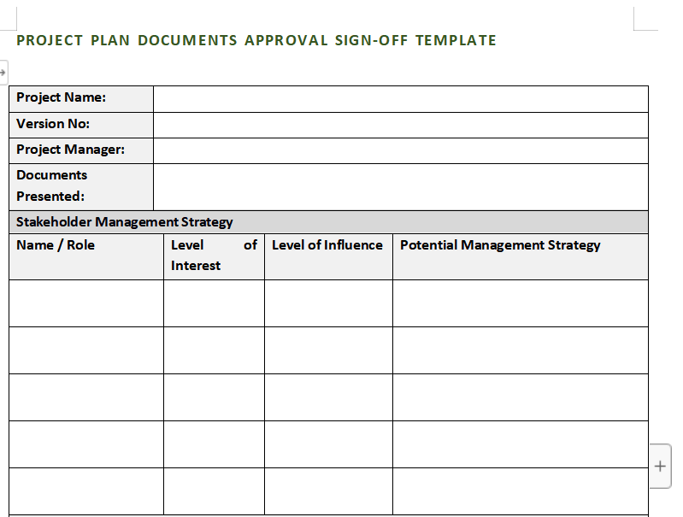
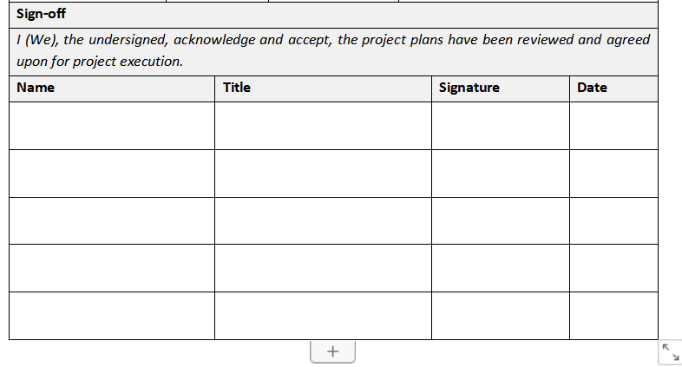

Slide 24
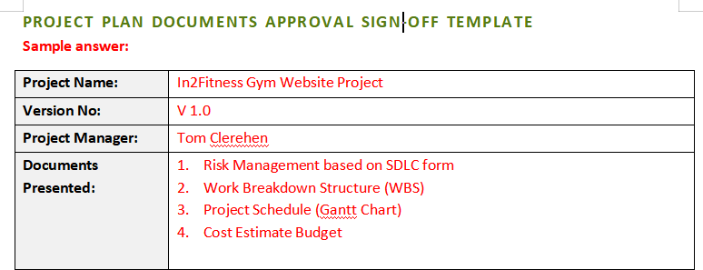
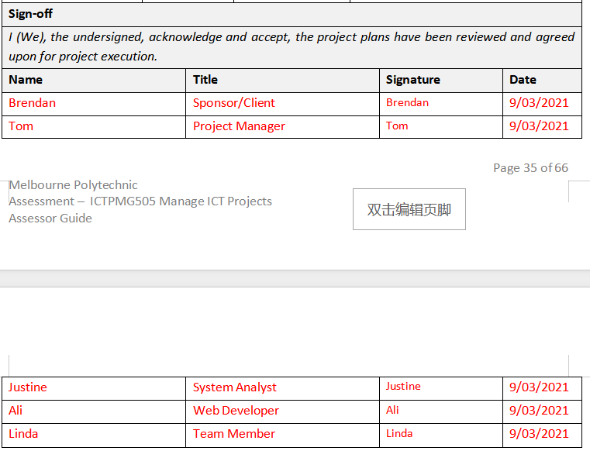
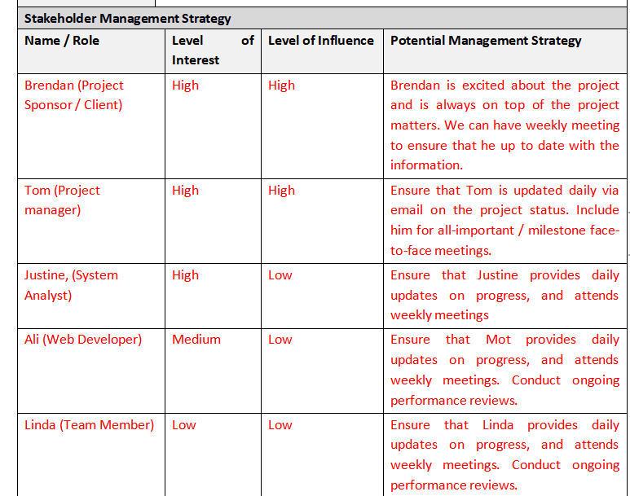
Example “Project plan Approval sign off” template
DO NOT COPY AND PASTE

Slide 25
Notice!
Please be informed that all properly completed documents for this Part 2, will be assessed by @ Folasade On Friday 26th of July, 2024.
Then we can proceed to the Part 3 of this assessment task.

Slide 26

Please see your WeChat for more forms and other information.请查看您的微信以获取更多表格和其他信息。 Please contact me @Folasade @ WeChat if you have any questions.如果您有任何问题，请@Folasade@微信与我联系。 Thank you! 谢谢！

